Slide 1
Beck Anxiety Inventory
By: Kelly Elker and Brad Mellor

Slide 2
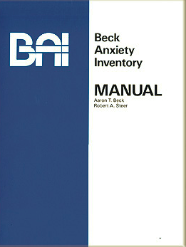
Test Information

Slide 3
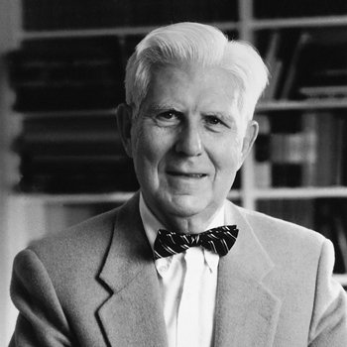
Background Information
Test Name: Beck Anxiety Inventory (BAI)
Developed: 1988 by Aaron Beck and his associates to assess symptoms of anxiety psychiatric outpatients
Currently using the 1993 version as it recommends different scoring guidelines than previous editions
Cost: Digital online or print version available online
Pearson: Print and Digital is $90.25 – prices vary (Pearson, 2019).
Available in Spanish
Image Retrieved from: http://www.laskerfoundation.org/awards/show/development-of-cognitive-therapy-theory-and-practice/

Slide 4
Background Information Continued
The Beck Anxiety Inventory (BAI) is a well-used assessment tool and a self-report questionnaire for dealing with symptoms of anxiety. Feelings such as nervous, scared and fearful of events are included (Carney, Moss, Harris, Edinger, & Krystal, 2011).
The BAI was also created to distinguish between client symptoms of anxiety and those with depression (Carney, et. al, 2011). Beck understood the comorbidity of anxiety and depression and wanted to create a scale to minimize symptoms of depression (Beck & Steer, 1987).
BAI was drawn from three previous self reporting anxiety measurements. The Anxiety Checklist (PDR; Beck, 1978) which measures anxiety severity, the Situational Anxiety Checklist which measures somatic and cognitive symptoms of anxiety (SAC; Beck, 1982) and the Preliminary Design Review Check List used for side effects of medication for anxiety and depression(PDR; Beck, 1978).

Slide 5
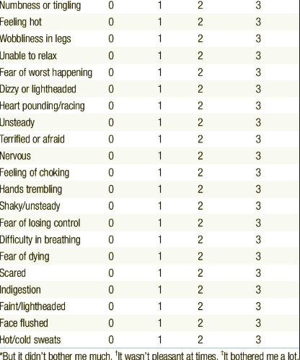
Test Contents
21 item self-report inventory for measuring severity of anxiety. Manual included.
The BAI includes a 21-items, rated on a 4 point Likert scale where a (0= no symptoms) and (3= symptoms are severe) (Carney, et. al, 2011). The results and raw scores of the BAI can then be categorized into four levels of anxiety of (minimal, mild, moderate, severe) and also determine the type of anxiety such as neurophysical, subjective, panic and autonomic (Hays, 2013).
21 items are the following; Numbness and tingling, Feeling hot, Wobbliness in legs, Unable to relax, Fear of the worst happening, Dizzy or lightheaded, Heart pounding or racing, Unsteady, Terrified, Nervous, Feeling of choking, Hands trembling, Shaky, Fear of losing control, Difficulty in breathing, Fear of dying, Scared, Indigestion or discomfort in abdomen, Faint, Face flushed, Sweating (not due to heat).

Slide 6
Administration and Scoring
It takes approximately 5 and 10 minutes to complete when self- administered
Oral administration takes around 10 minutes
Should be used and interpreted only by professionals with appropriate clinical training and experience
BAI total score for interpreting anxiety use the following;
0-7 minimal level of anxiety
8-15 mild anxiety
16-25 moderate anxiety
26-63 severe anxiety
Each symptom is rated on a 4-point scale ranging from 0 to 3 with a maximum score of 63
(Beck & Steer, 1993)

Slide 7
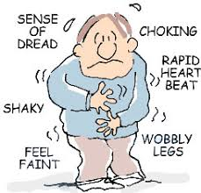


Subscales
Subscales based on cluster analysis
Neurophysiological
Dizzy or lightheaded
Subjective
Fear of losing control
Panic
Heart pounding or racing
Autonomic
Feeling hot
Image Retrieved from: https://www.svjhscounseling.com/panic-disorder.html
Subscales by type of anxiety disorder
Panic disorder with Agoraphobia
Panic disorder without Agoraphobia
Social Phobia
Obsessive-Complusive Disorder
Generalized Anxiety Disorder
(Beck & Steer, 1993)
Image Retrieved from: https://www.psycom.net/do-i-have-ocd-test
Image Retrieved from: https://counsellingservicevancouver.com/social-anxiety/
Notes:
Certain questions line up with

Slide 8
Theoretical Information

Slide 9

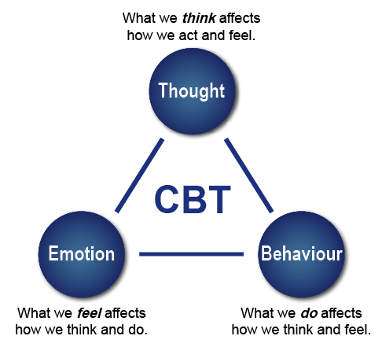
Theoretical Framework: Within Literature
Cognitive behavioural therapy (CBT) emerged from Aaron Beck’s research and development on Cognitive therapy (CT) in the 1960’s (Beck & Weishaar, 2014).
Beck was interested in using empirically theory, evidence based practices backed by science (Truscott, 2010)
Cognitive therapy based on how humans make sense and meaning and how this influences our way of thinking, behaving and feeling (Truscott, 2010)
Cognitive behavioural therapy is recommend as the first line of treatment and the most studied psychological treatment for anxiety disorders (Arendt, Thastum, & Hougaard, 2015).
Image Retrieved from: https://en.wikipedia.org/wiki/Aaron_T._Beck
Image Retrieved from: https://www.in8.uk.com/2013/05/how-is-this-different-to-cognitive-behavioural-therapy/

Slide 10
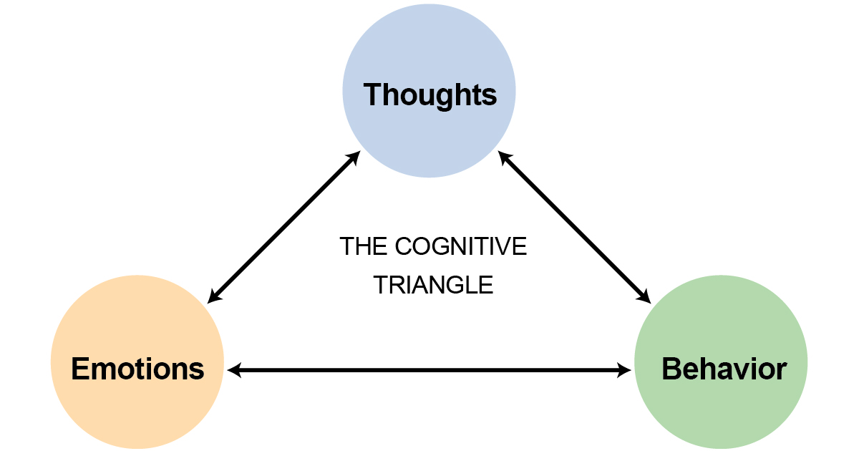
Theoretical Framework: Does the theory fit the model?
Items match theory
Manual is similar to the core concepts of CBT to explain thoughts, feelings, and behaviours
Example: Unable to relax
What thoughts are going through your head when you are unable to relax?
How do you feel when you are unable to relax?
What behaviours do you partake in when you are unable to relax?
Image Retrieved from: https://peterwalkerandassociates.com.au/what-is-cbt/

Slide 11
Development and Psychometrics

Slide 12
Development and Evaluation
The Beck Anxiety Inventory addressed the distinctiveness of anxiety and depression but many assessment tools although were reliable and valid demonstrated high correlations (r= .50). (Beck, Brown, Epstein & Steer, 1985).
Found that when the focus is on theory and clinical practice, in the early stages of creating assessments, item validity is often overlooked (Beck et. al, 1985).
Beck’s team attempted to shift items to create a relevant scale using items from outside tools such as the Hamilton Rating Scale (Hamilton, 1959, 1960). When the scale was revised there was a decreased correlation between anxiety and depression (Beck et. al, 1985).

Slide 13
Reliability
Reliability Type | Correlation | Reference
Internal Consistency | Cronbachs Coefficient alpha of .92 | (Muntingh, van der Feltz-Cornelis, van Marwijk, Spinhoven, Penninx & van Balkom, 2011)
Test Retest (within one week time) | r =.75 (p< .001) | (Beck, Epstein et al, 1988)

Slide 14
Validity (Content)
Content Validity: Representativeness of test items based on population of items (Hays, 2013).
BAI (Beck’s Anxiety Inventory) is based on the symptoms of anxiety that corresponds and relates to the guidelines and criteria of anxiety disorders found in the DSM-III-R including panic and generalized anxiety disorders (Beck & Steer, 1993).

Slide 15
Validity (Construct)
Construct Validity: Used to measure the BAI for depression as it was created to minimize this (Hays, 2013). Beck, Epstein et al. (1988) argue that the BAI has lower correlations to depression as other anxiety related self-report measures do which have an (average r> .50).
Assessment | Correlation r/p values | References
Hamilton Psychiatric Rating Scale for Depression-Revised | r = .25 (p< .05) | (Riskind et. al, 1987)
BDI | r = .48 (p< .001) | (Beck & Steer, 1987)
CCL Depression Subscale (frequency of cognitions related to depression) | r = .22 (p< .05) | (Beck et al., 1987)
BDI (Beck’s Depression Inventory) | r = .50 (p< .001) | (Fydrich et al, 1990)
Maudsley Obsessional- Compulsive Inventory | r = .61 (p< .001) | (MOC; Hodgson & Rachman, 1977)
Notes:
Hamilton Anxiety Rating Scale (.51) (Beck et al., 1988)
Bec, Epstien, Brown, & Steer 1988

Slide 16
Validity (Concurrent)
Concurrent Validity: Test scores taken at the same time at the BAI (Hays, 2013)
Assessment | Correlation r/p values | References
Hamilton Anxiety Rating Scale | r= .51 (p < .001) | (Hamilton, 1959; Riskind, Beck, Brown & Steer, 1987)
Cognition Checklist (dysfunctional cognitions relating to anxiety) | r= .51 (p< .001) | (Beck, Brown, Steer, Eidleson & Riskind, 1987)
State-Trait Anxiety Inventory | Trait r= .58 (p< .001) State r= .47 (p< .01) | (STAI; Speilberger, 1983)
WRAD (Weekly Record of Anxiety and Depression 7 day rating scale | r= .54 (p < .001) | (WRAD; Barlow & Cerny, 1988)

Slide 17
Validity (Discriminant)
Discriminant Validity: Test scores that do not correlate should also show discriminant validity to show how they differ (Hays, 2013). The BAI was created also to discriminate between several combinations of anxiety disorders along with other secondary disorders (Beck & Steer, 1993).
* moderate overlap between the two scores. Beck & Steer (1993) explain that 25% of the anxiety group had higher scores than the highest score in the group with depression.
*Scheffe was also able to determine that clients with panic disorders had higher scores than those with generalized anxiety disorder (Beck & Steer, 1993).
BAI Scores/ group | number/range/median
Primary Anxiety disorder (no depression) | (n = 82) ranged from 2-58 (median = 24)
Primary Depression disorder (no anxiety) | (n = 30) ranged from 1-31 (median = 13)

Slide 18
Factorial Validity
Factorial Validity or Factor Analysis: Determines whether the test items fall according the theory of the assessment and the degree of the covariance of items match real life (Hays, 2013). In this case the BAI Beck Anxiety Inventory should indicate principles of Cognitive Rationale reflecting thoughts, feelings and actions (Truscott, 2010).
Factor | Description of Symptoms
Physical symptoms | Numbness, feeling hot, shaky, sweating
Subjective and panic thinking | Fear of worst, fear of losing control, terrified
A BAI cluster analysis regarding covariance was created for a study group of 393 patients who suffered from anxiety (Beck & Steer, 1993). Four main clusters were found.
Neurophysiological symptoms (Hands trembling)
Subjective symptoms (Nervous)
Panic (Heart pounding)
Autonomic (Sweating not due to heat)

Slide 19
Validity Continued
Kumar, Steer, and Beck (1993) explain that the BAI has demonstrated validity similar to anxiety measures for adults and also correlates with the results of the Revised Children’s Manifest Anxiety Scale with a score of .62 for 54 inpatients.
The internal consistency of the BAI which measures how closely the assessments items with one another with a coefficient alpha score of .91 demonstrating a high degree of internal reliability while factor analysis identified 2 factors resembling structure from the results of adult patients (Kumar et. al, 1993; Sheperis, Young, & Daniels, 2017)
Kumar et. al (1993) also state that the internal consistency demonstrates that the BAI is a useful instrument for measuring self-reported anxiety in adolescent clients.
Notes:
***** shorten this.

Slide 20
Norming Process
Beck, Epstein et al. (1988) included three samples of psychiatric outpatients (Beck & Steer, 1993)
Total number of outpatients was 1,086
Beck & Steer (1993) explain that patients were chosen from pool of candidates with mood and anxiety disorders but also a variety of other disorders were present.
Final subsample were 160 outpatients
Fydrich et al (1990) conducted a similar study with two samples
BAI used in non clinical samples (Dent & Salkovskis, 1986)
Major Depression | 40 | 25%
Dsythymic Depression | 11 | 6.9%
Panic with Agoraphobia | 45 | 28.1%
Agoraphobia with panic attacks | 18 | 11.2%
Social/ Simple Phobia | 12 | 7.5%
GAD | 18 | 11.2%
Miscellaneous, nonanxiety, nondepression, academic problems | 16 | 10.0%
Population | N | percentage | mean age | SD
Men | 456 | 42% | 36.4 years old | 12.4
Women | 630 | 58% | 35.7 years old | 12.1

Slide 21
Clinical / Practical Applications

Slide 22
Literature and Clinical Tools
The five most frequently used assessment instruments among mental health counselors are the Beck Depression Inventory, Beck Anxiety Inventory, WAIS, Mini-Mental State Examination, and the Myers–Briggs Type Indicator (Peterson et al., 2014)
Most commonly used instrument for detecting anxiety (Pearson, 2019)
Most literature found uses BAI to assess anxiety in populations
Results can be used to differentiate different anxiety disorders (Hays, 2017)
Notes:
*** add more

Slide 23
Commentary

Slide 24
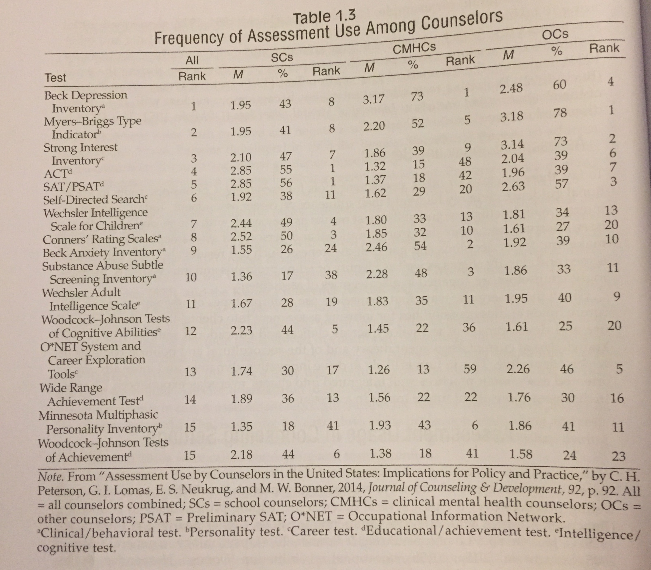
Strengths
Very commonly used assessment tool, ninth overall (Hays, 2017)
Computer software program available, even in 1993 (Beck & Steer, 1987)
Empirically reviewed in terms of being reliable and valid
Can be easily administered as part of a counselling interview (Hays, 2017)
Results can be used to differentiate different anxiety disorders (Hays, 2017)
Assess a broad range of emotional, physical, cognitive and behavioral symptoms that represent important dimensions of anxiety.
Image Retrieved from: Hays (2017)
Notes:
The clinical can then further assess using DSM criteria to arrive at a specific diagnostic category and plan interventions targeting the underlying cause of the respondent's anxious symptomatology and/or diagnosis.
Looking at panic, generalized, ect.

Slide 25
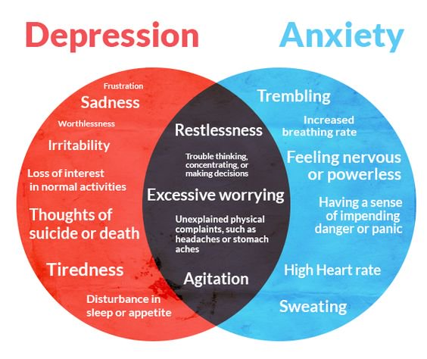

Weaknesses
Dated, as our descriptions of anxiety may have changed.
Norming- the BAI - multicultural considerations
Further research needed to establish clusters for diverse clinical populations (Beck & Steer, 1993).
Ethical Considerations: 14 out of 40 cited references for the BAI had Beck involved
Manual didn’t have any instructions on determining the results
Limitations with the BAI in regards of discriminating between anxiety and depression. Dutch Study in which Muntingh et al., 2011).
Mean and median reliability estimates tend to be lower when given to a nonpsychiatric population, such as University students, than when given to a psychiatric population (De Alaya, Vonderharr-Carlson, & Kim 2005).
Image Retrieved from: https://missheardmedia.com/mental-health-201-anxiety-and-depression-by-lindsey-turnbull/
Image Retrieved from: https://www.acfe.com/code-of-ethics.aspx

Slide 26

Utility and Suggested Clients
Can be easily administered as part of a counselling interview and used as a check in and monitor a client’s progress over time (Hays, 2017)
The BAI requires only a basic reading level (2-3), can be used with individuals who have intellectual disabilities (Lindsay & Skene, 2007)
Most commonly used instrument for detecting anxiety (Pearson, 2019)
Has been adapted for children and youth
Beck Anxiety Inventory Youth (BAI-Y)
Image Retrieved from: http://cookstreetvillageactivitycentre.com/event/friends-of-all-ages-drop-in/2018-03-07/
Notes:
The BAI-Y consists of twenty self report items rated on a three point scale that assess a child's fears, worrying, and physiological symptoms associated with anxiety. Like the other Beck Youth Inventories, it can be used with patients aged 7-18 and is also copyrighted and available from Pearson. Because it was specifically developed and normed on children aged 7-14, it is a more appropriate measure of anxiety in patients in that age range and slightly higher. If appropriate, the clinician can use the adult form of BAI for the ending adolescent years and with young adult patients
Leyfer O.T., Ruberg, J.L., Woodruff-Borden, J. (2006). Examination of the utility of the Beck Anxiety Inventory and its factors as a screener for anxiety disorders. Journal of Anxiety Disorders, 20 (4), 444–458. *** could be a good resource

Slide 27
References
Arendt, K., Thatsum, M., & Hougaard, E. (2016). Homework adherence and cognitive behaviour treatment outcome for children and adolescents with anxiety disorders. Behaviour and Cognitive Psychotherapy, 44, 225-235. DOI: 10.1017/S1352468515000429
Barlow, D., & Cerny, J. (1988). Psychological treatment for panic. New York, New York: Guilford.
Beck, A. (1978). PDR Check List. Philadelphia: University of Pennsylvania, Centery for Cognitive Therapy.
Beck, A. (1982). Situational Anxiety Checklist. Philadelphia: University of Pennsylvania, Center for Cognitive Therapy.
Beck, A., & Steer, R. (1993). Beck Anxiety Inventory. Beck Anxiety Inventory Manual. San Antonio: The Psychological Corporation.
Beck, A., & Weishaar, M. (2014). Cognitive Therapy. In D. Wedding, & R. Corsini, Current Psychotherapies (10th ed.) (pp. 231-264). Belmont, California: Broks Cole, Cengage Learning.
Beck, A., Epstein, N., Brown, G., & Steer, R. (1988). An inventory for measuring clinical anxiety: Psychometric properties. Journal of Consulting and Clinical Psychology, 56, 893-897.

Slide 28
Carney, C., Moss, T., Harris, A., Edinger, J., & Krystal, A. (2011). Should we be anxious when assessing anxiety using the beck anxiety inventory for clinical insomnia patients? Journal of Psychiatric Research, 45, 1243-1249.
De Ayala, R., Vonderharr-Carson, D., & Kim, D. (2005). Assessing the reliabiltiy of the beck anxiety inventory scores. Educational and Psychological Measurement, 65(5), 742-756. Doi: 10.1177/00013164405278557
Dent, H., & Salkovskis, P. (1986). Clinical measures of depression, anxiety and obsessionality in nonclinical populations. Behavioral Research and Therapy, 24, 689-691.
Fydrich, T., Dowdall, D., & Chambless, D. (1990, March). Aspects of reliability and validity for the beck anxiety inventory. Paper presented at the National Conference on Phobias and Related Anxiety Disorders. Bethesda, MD.
Hamilton, M. (1959). The assessment of anxiety states by rating. British Journal of Medical Psychology, 32, 50-55.
Hamilton, M. (1960). A rating scale for depression. Journal of Neurology, Neurosurgery, and Psychiatry, 23, 56-61.
Hays, D. G. (2017). Assessment in Counseling: Procedures and Practices (6th Ed.). Alexandria, VA: American Counseling Association.
Hodgson, R., & Rachman, S. (1977). Obsessional-compulsive complaints. Behavioral Research Therapy, 15, 389-395.

Slide 29
Hamilton, M. (1959). The assessment of anxiety states by rating. British Journal of Medical Psychology, 32, 50-55.
Hamilton, M. (1960). A rating scale for depression. Journal of Neurology, Neurosurgery, and Psychiatry, 23, 56-61.
Hays, D. G. (2017). Assessment in Counseling: Procedures and Practices (6th Ed.). Alexandria, VA: American Counseling Association.
Hodgson, R., & Rachman, S. (1977). Obsessional-compulsive complaints. Behavioral Research Therapy, 15, 389-395.
James, A., James, G., Cowdrey, F., Soler, A., & Choke, A. (2018). Cognitive behavioural therapy for anxiety in children and adolescents (review). Cochrane Database of Systematic Reviews , 2, 1-105. Doi:10.1002/14651858.CD004690.pub4.
Kumar, G., & Steer, R. (1993). Factor structure of the beck anxiety inventory with adolescent psychiatric inpatients. Anxiety, Stress Coping, 6(2), 125-131.

Slide 30
Lindsay, W., & Sekene, D. (2007). The beck depression inventory II and the beck anxiety inventory in people with intellectual disabilities: factor analyses and group data. Journal of Applied Research in Intellectual Disabilities, 20(5), 401- 408.DOI:10.1111/j.1468-3148.2007.00380.x
Manincor, M., Bensoussan, A., Smith, C., Barr, K., Schweickle, M., Donoahoe, L., . . . Fahey, P. (2016). Individualized yoga for reducing depression and anxiety, and improving well being: A randomized controlled trial. Depression & Anxiety, 33, 816-828. Doi:10.1002/da.22502
Muntingh, A., van der Feltz-Cornelis, C., van Marwijk, H., Spinhoven, P., Penninx, B., & van Balkom, A. (2011). Is the beck anxiety inventory a good tool to assess the severity of anxiety? A primary care study in The Netherlands study of depression and anxiety (NESDA). Family Practice.
Peterson, C., Lomas, G., Neukru, E., & Bonner, M. (2014). Assessment use by counselors in the united states: implications for policy and practice. Journal of Counseling & Development, 92, 90-98.DOI: 10.1002/j.1556-6676.2014.00134.x

Slide 31
Riskind, J., Brown, G., & Steer, R. (1987). Taking the measure of anxiety and depression: Validity of the reconstructed hamilton scales. Journal of Nervous and Mental Disease, 175, 129-136.
Sheperis, C., Young, S., & Daniels, H. (2017). Counseling Research Quantitative, Qualitative, and Mixed Methods. United States: Pearson.
Spielberger, C. (n.d.). Manual for the State- Trait Anxiety Inventory (Form Y). Palo ALto, California: Consulting Psychologists Press.
Truscott, D. (2010). Becoming an effective psychotherapist- adopting a theory of psychotherapy that's right for you and your client. American Psychological Association.

